Slide 1

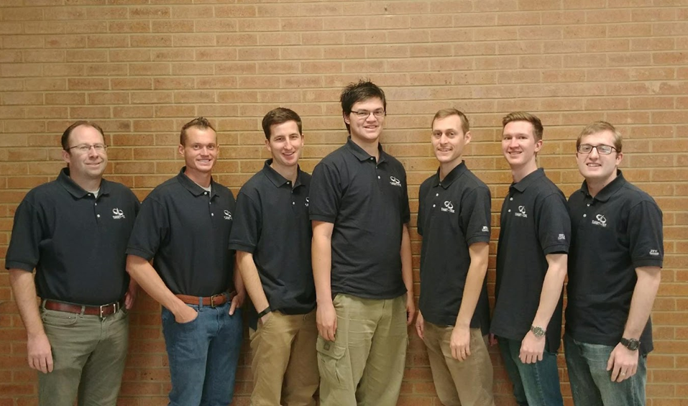
Autonomous System to Establish Reference Direction for Large Ground-Based Antennas

Slide 2
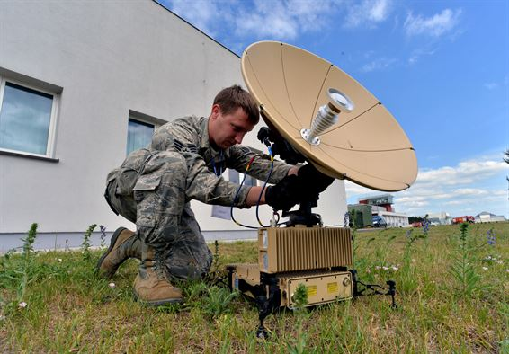
Boresighting
Aligning an antenna with a target
Tight accuracies
Slow process (2 days)
Labor intensive
Long distances between required measurements
Expensive equipment

Slide 3
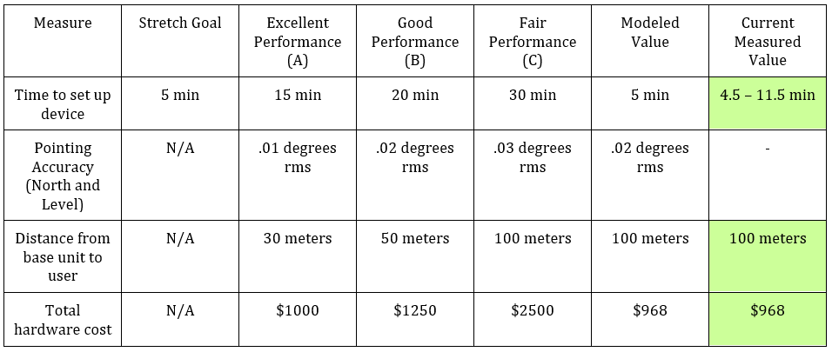
Key Success Measurements

Slide 4
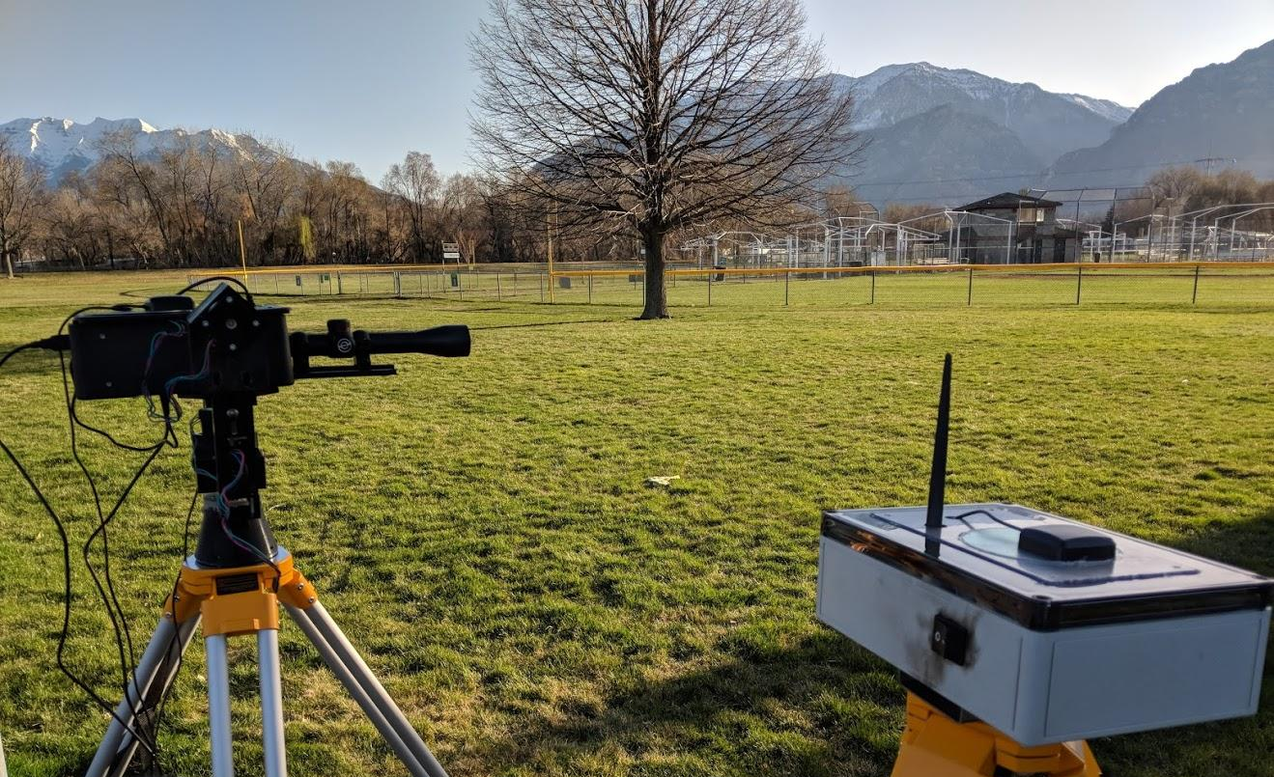
Our Solution

Slide 5
Step by Step Process
Set up base station
Initiate GPS and leveling procedure
Place mobile station
Align gimbal with the mobile station
Input GPS coordinates of the target

Slide 6
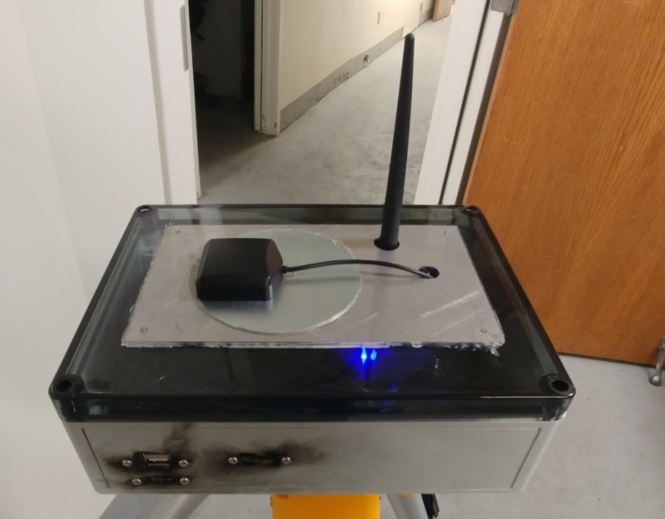
Place Mobile Station
Place mobile station about 100m from antenna
Place in clearing
Avoid multipath
taller is better
Turn on device
Check that blue LED is on
Automatically begins survey-in

Slide 7

Rover Setup
Takes 20 seconds to set up rover
Once powered, the rover automatically starts surveying-in and will send RTK correctional data to base station once they survey-in is finished

Slide 8
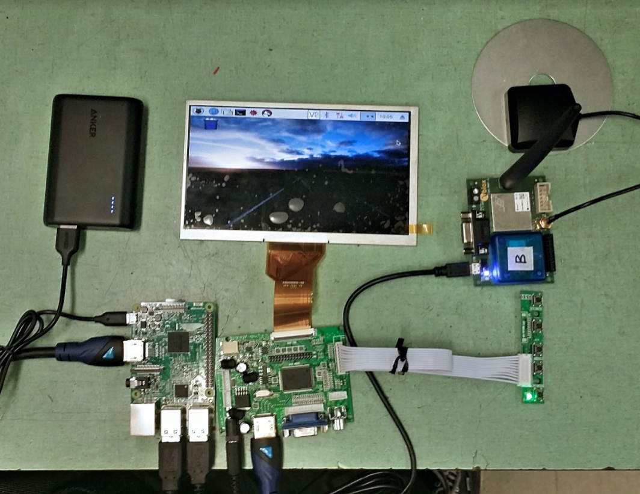
North Finding
RTK GPS system
Located in both units
Finds relative position between both units
Survey in
RTK fix
Calculates north vector

Slide 9
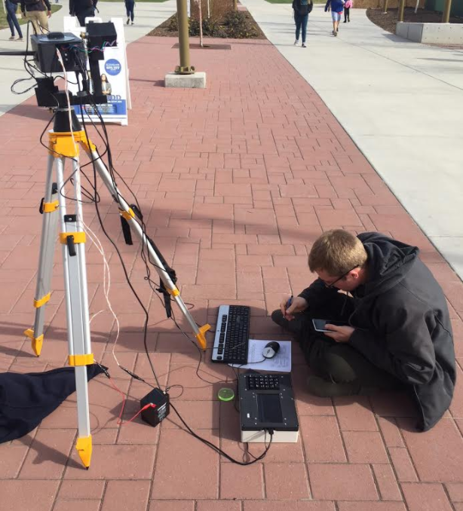
Interfacing and Testing
Pi interacts with Ublox via Serial (NMEA protocol, mostly proprietary UBX)
Survey-In, High Precision Position, RTK status, relative Position, Message Enable.
Surveying in at Y
Surveying in/Surveying targets at Park
Timing variability

Slide 10
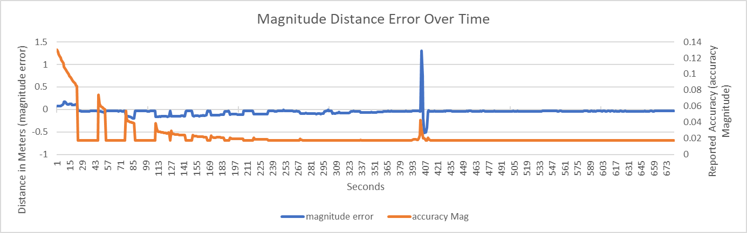
Testing and Validation
Time: Variable but typically 2 minutes
Determine location with centimeter accuracy
0.014° accuracy

Slide 11
Testing and Validation
RTK Solution measured accuracy: 2.6 cm
Predicted of 1.732 cm (in 3 Dimensions)
Time to establish an RTK Fix: 1-5 minutes
Highly Variable (atmosphere, multipath, baseline length, satellite visibility)
Survey-in Accuracy:
1.4197m in 1 min
1m in 13 mins,
.54m in 42 mins,
.55m in 97 mins (on Y mountain, bad multipath)
No observable correlation between survey-in time and RTK fix time

Slide 12
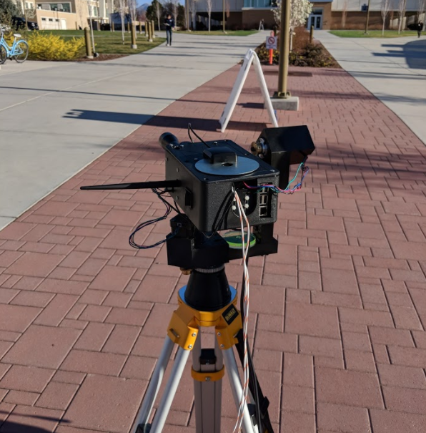
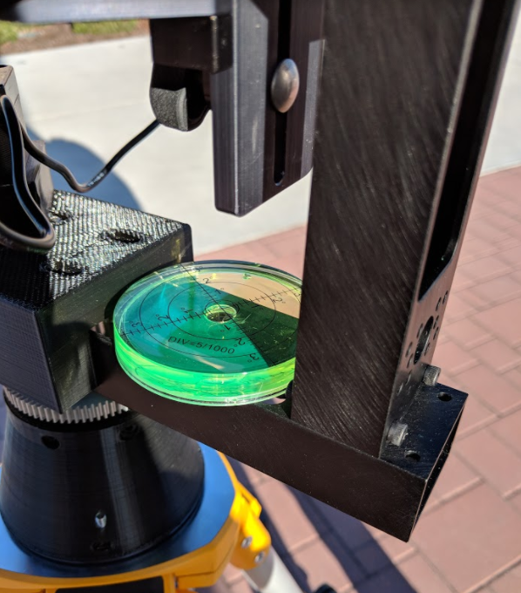
Setup Base Station
Setup Tripod
5° of level
Connect to power
Turn on system
Follow UI

Slide 13
Base Station Setup
Takes roughly 1 minute to set up base station

Slide 14
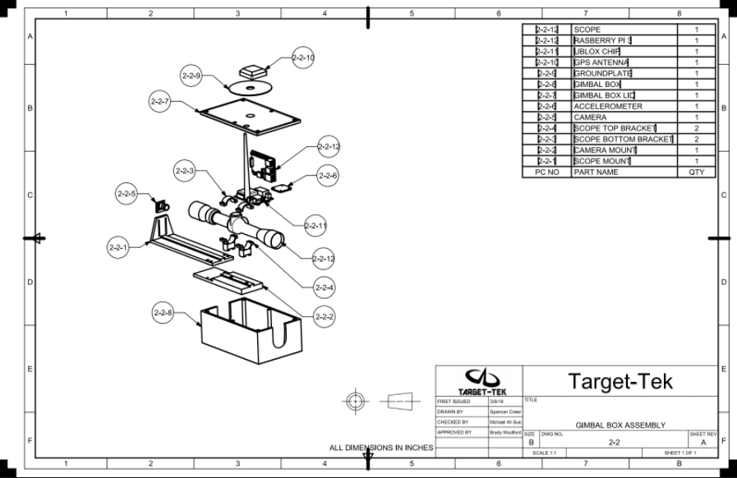
Align Gimbal and Mobile Station
Creates a reference location for the gimbal
Manually established using a scope camera system

Slide 15
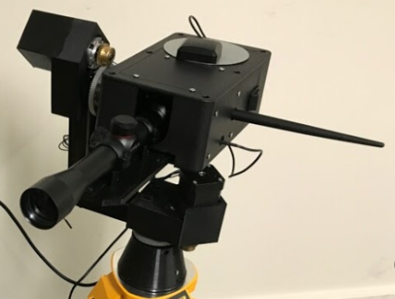
The Gimbal
Allows alignment of the entire
system and pointing at the final target
Two axis of rotation
Ramping function
Encoders
Accuracy: 0.002° per step
Rotation Speed: 1 RPM

Slide 16
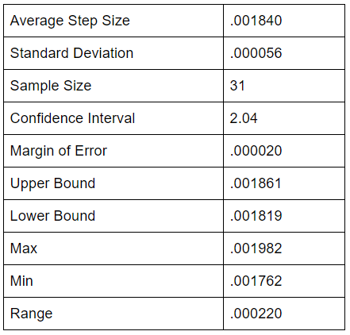
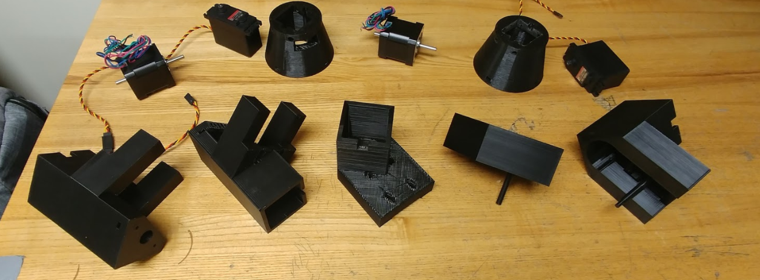
Design and Testing

Slide 17
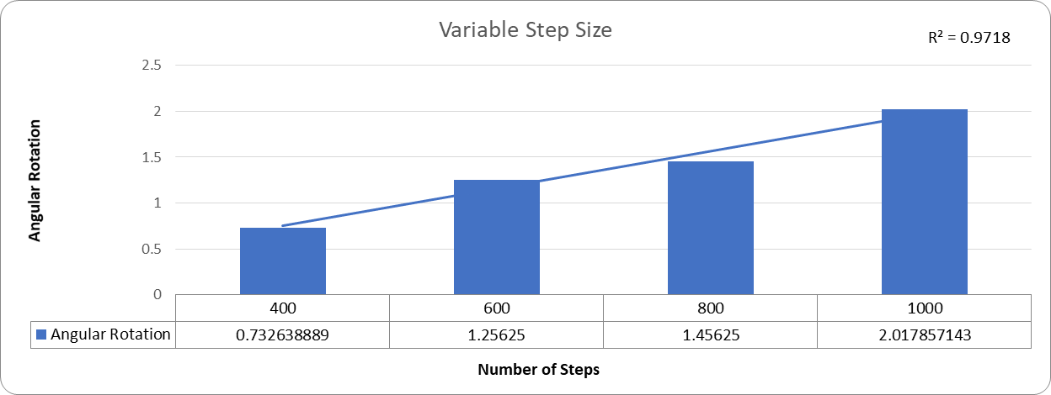
Additional Testing

Slide 18
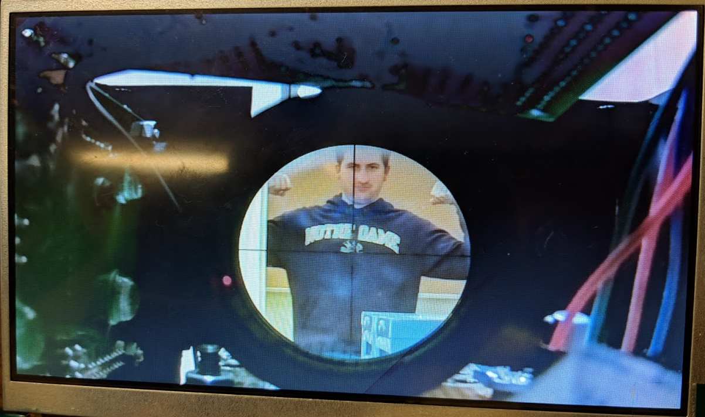
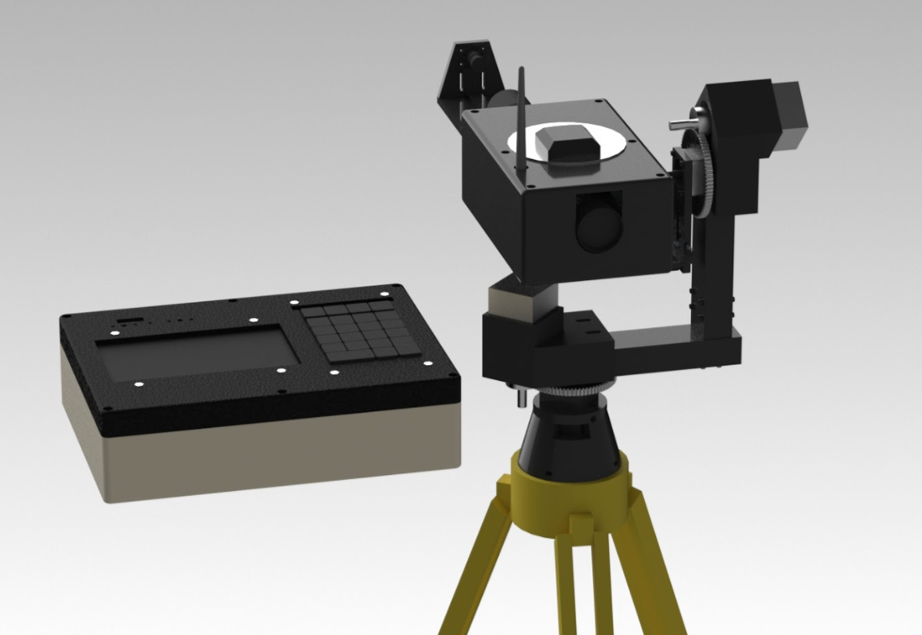
Manually Establishing The Baseline
Keypad controls gimbal
Visual display allows user to
establish the baseline
Scope is aligned with the U-blox
antenna
1” X 1” target easily found at 100
Meters
Accuracy: 0.01°

Slide 19
Baseline Setup
Align orientation of gimbal with baseline
This is accomplished by pointing the scope at the rover’s GPS antenna
Variable gimbal speed allows user to accurately point at rover

Slide 20
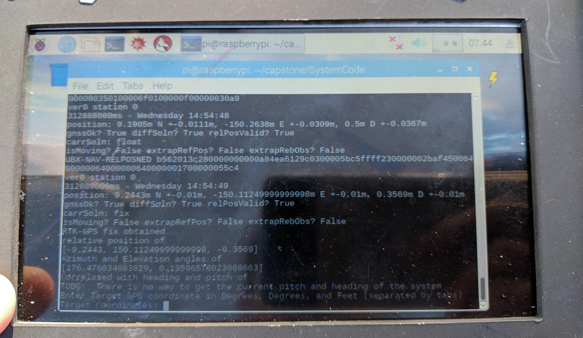
Input Pointing GPS Coordinates
UI navigation and target GPS coordinates are entered via keypad on the handheld

Slide 21
Level The Gimbal
Triple-axis accelerometer
The gimbal system pans in 45° intervals allowing the accelerometer to take readings at different locations
Self-levels
Rotates again to validate how level the system is

Slide 22
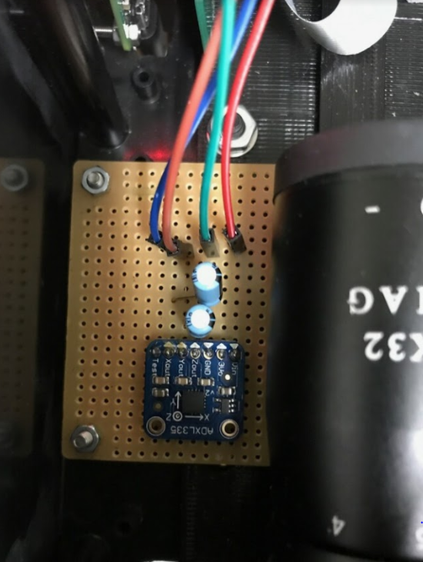
Testing and Validation
Noise verified to ≤ 1 LSB
17-bit ADC
Experimentally verified average offset from level of 0.012° over 10 trials

Slide 23
Self-Calibration

Slide 24
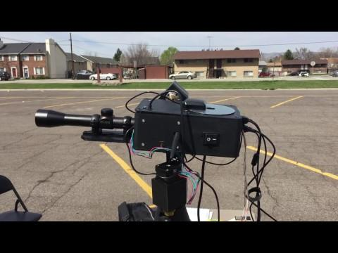
Full Test

Slide 25
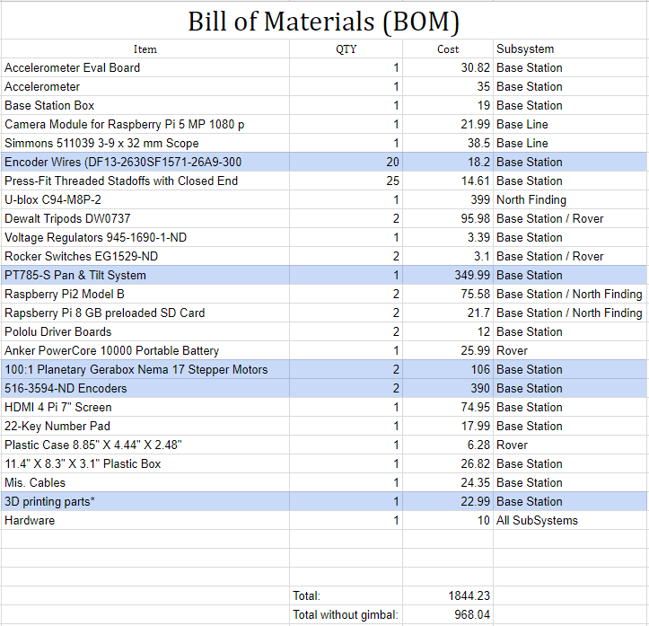
Cost
Gimbal costs not included in final cost of the system
Key Components
U-blox
Accelerometer
Simmons 3-9 power scope
7” screen
Raspberry Pi
Total Cost: $968

Slide 26
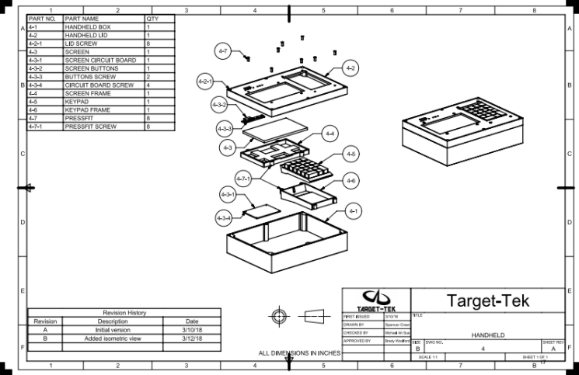
Deliverables
Full system
Design Package
Setup Procedure
Code
CAD models
Circuitry design
Testing and validation
procedures and data
Documented design process performed by the team

Slide 27
Recommendations
Object recognition for establishing baseline
Encoders
Self Leveling
Additional Testing
Replace 3D prints

Slide 28
Results

Slide 29
